Slide 1
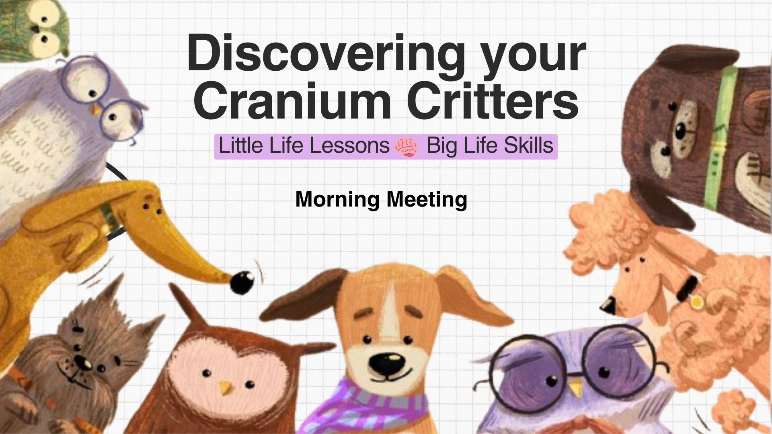

Slide 2
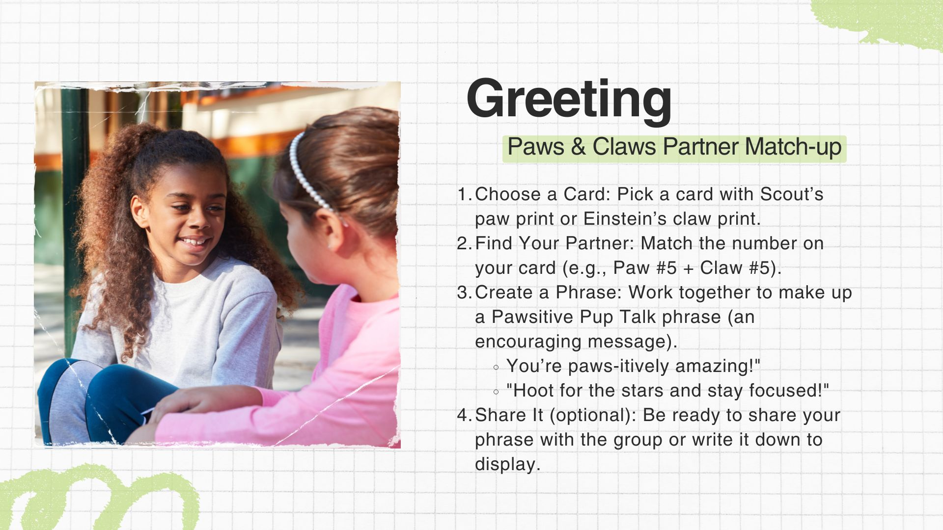

Slide 3

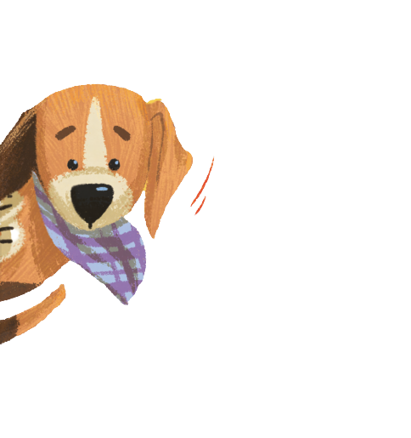



Mindful Moment
Star Breathing with Scout
  Follow along: Watch as the star grows and shrinks.
  Breathe In: Slowly as the star gets larger.
  Breathe Out: Gently as the star gets smaller.
  Match Your Breath: Let your breathing follow the star’s movements.
Video

Slide 4
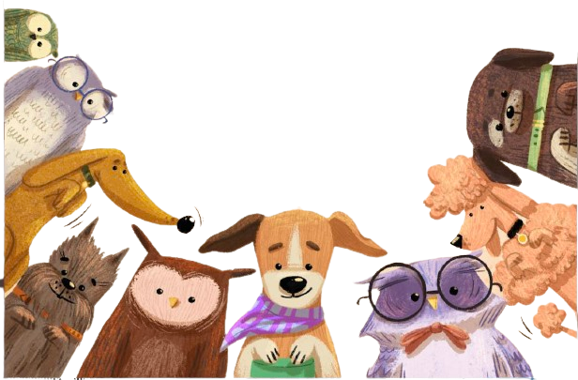

Let’s learn
about your
Cranium Critters!
Video
Notes:
Video linked to YouTube lesson with the author.

Slide 5
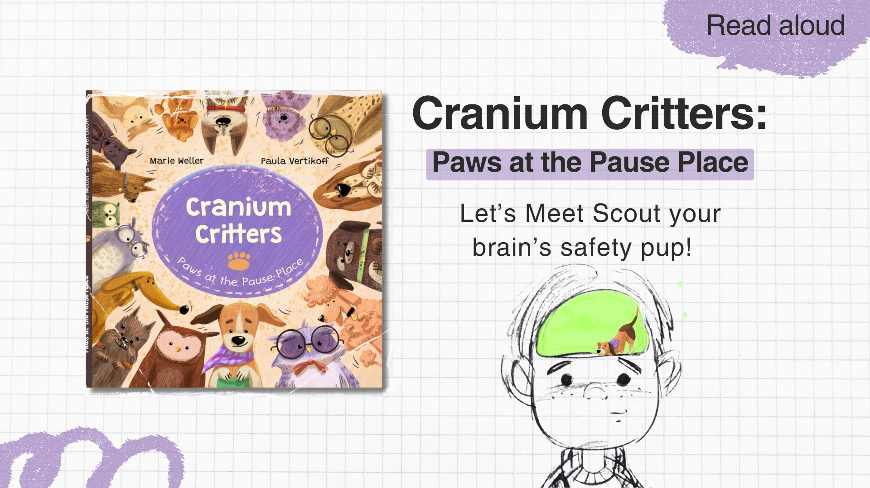

Slide 6
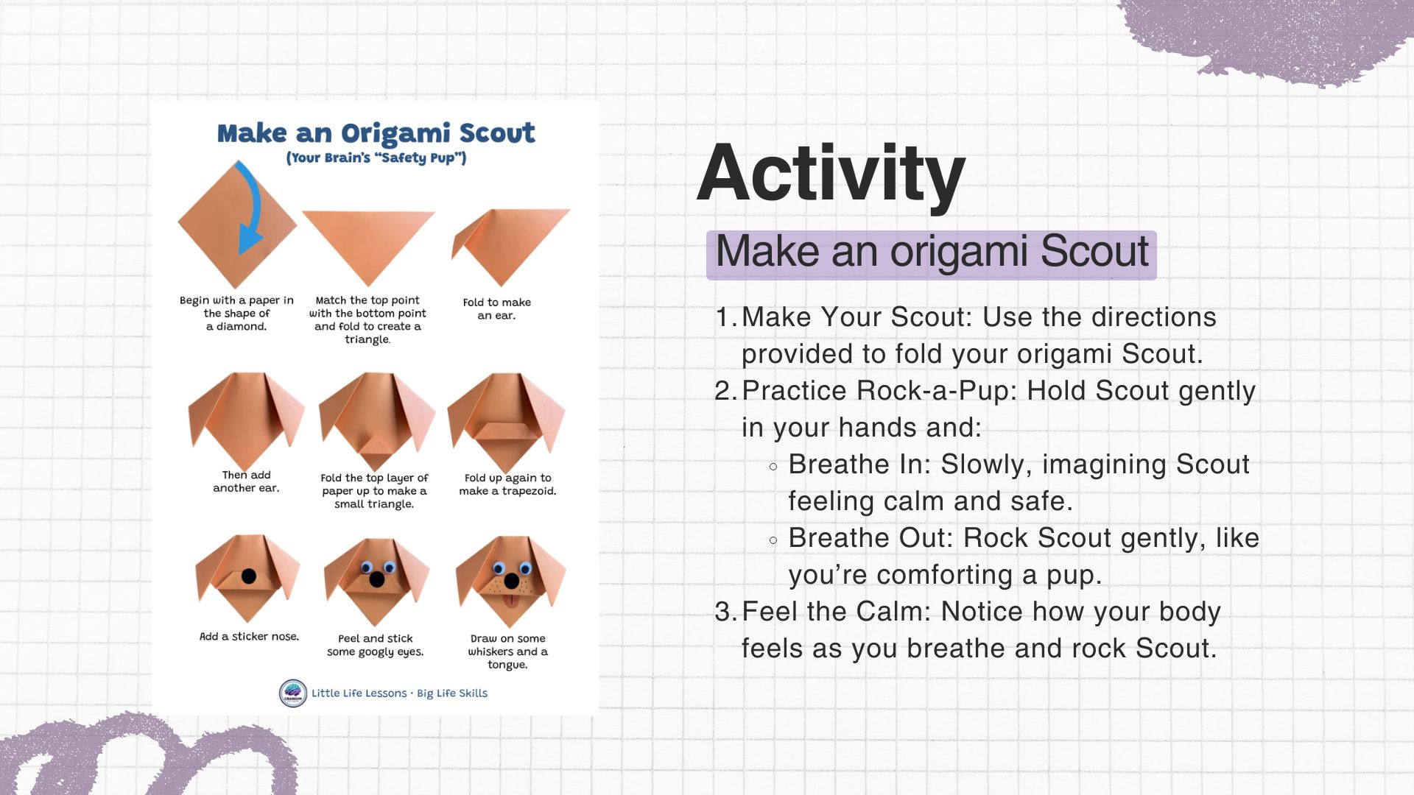

Slide 7













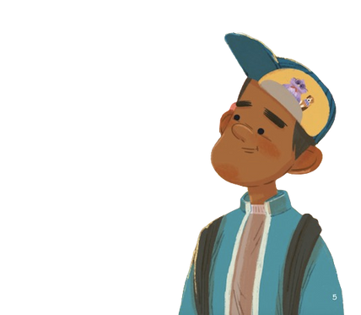
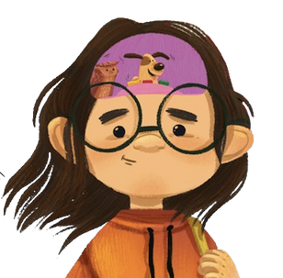


Pause Place
Tools
Stay Cool, Calm, and Connected
Notes:
Brianstorm a list of Pause Place Tools for your classroom or home

Slide 8
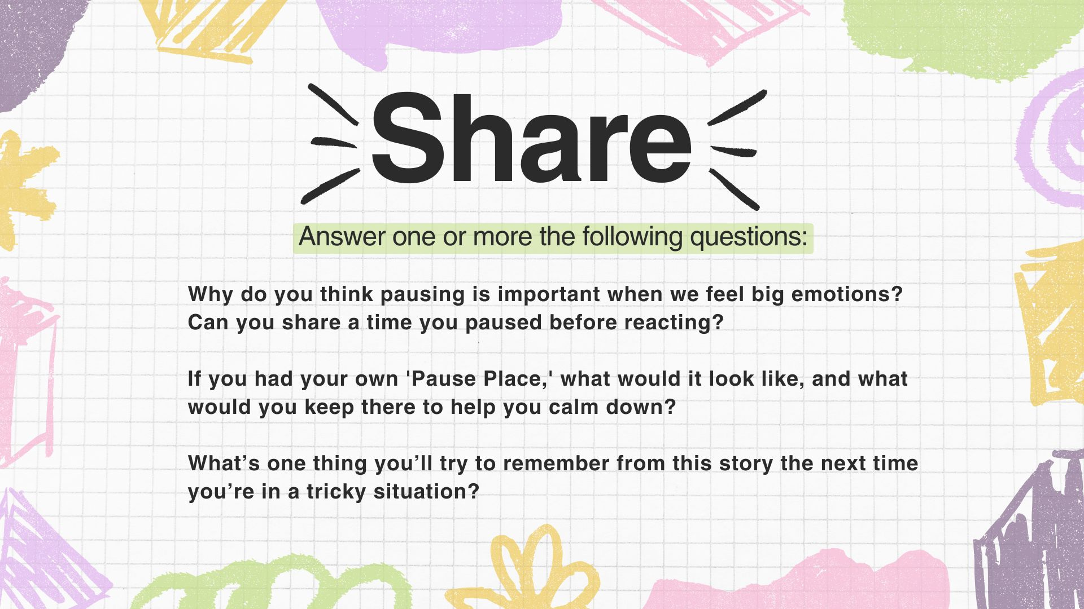

Slide 9
